Slide 1


NBA Statistical Analysis
By Andreas Sudarto,
Luc Ravenelle

Slide 2
Ideas and role collab
Predicting next year stat and who will have the better season
Using visualization
Roles:
Andreas: Scraping
Luc: Data analyzing and predicting

Slide 3


Tools
Language:
Python
R
Libraries:
BS4
xts
fpp2
forecast

Slide 4
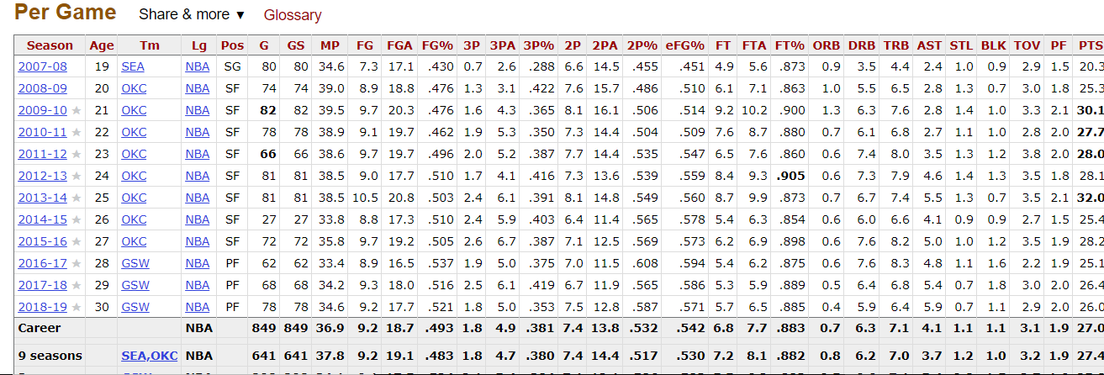
Source
NBA Reference
Table

Slide 5
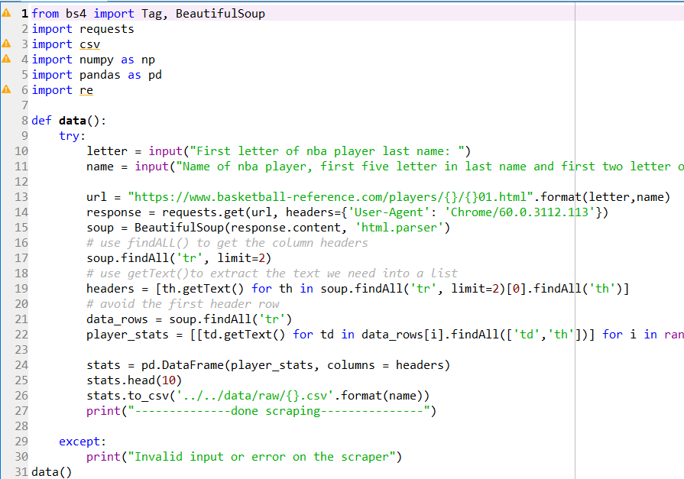
Scraping
Library BeautifulSoup
Scrape the TR and TH tag to get all the stats

Slide 6
Analysis
Method/Technique:
Using Training/Test set Data to make the prediction
Naïve Bayes
Drift Forecast

Slide 7
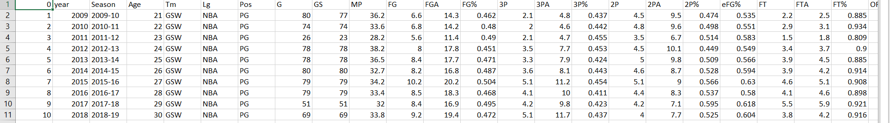
Data
Stats used for each player: Points avg, Assist avg, Adjusted Field Goal %, Turnover avg

Slide 8

Demo

Slide 9
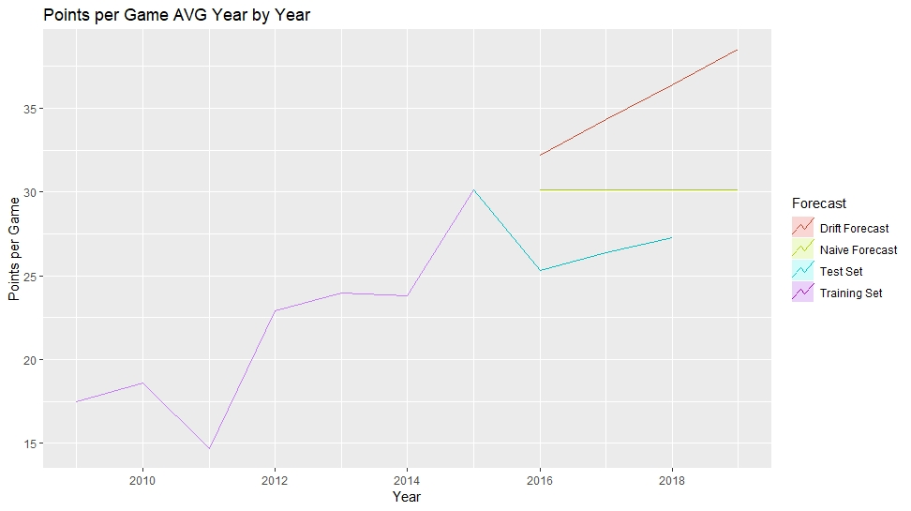
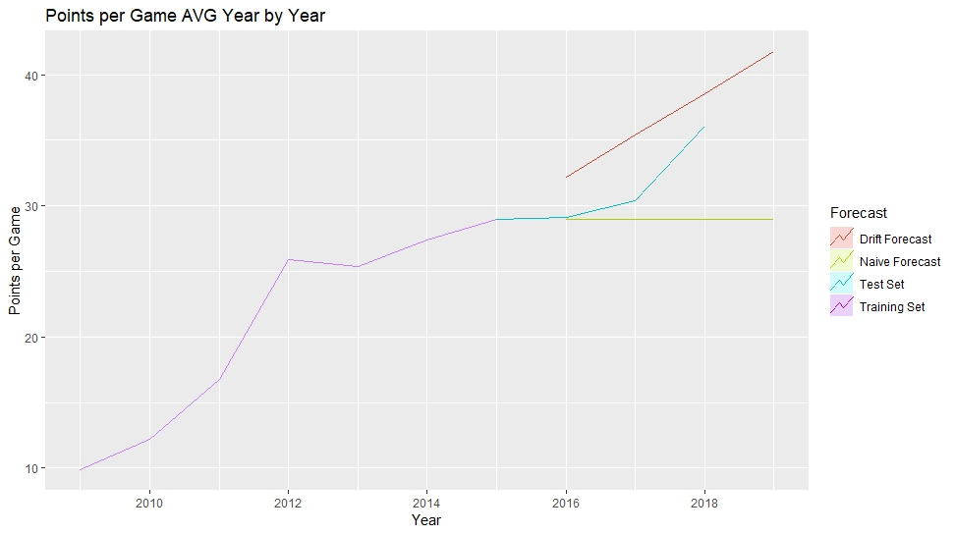
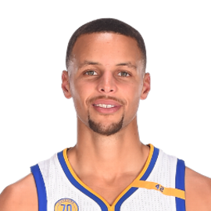
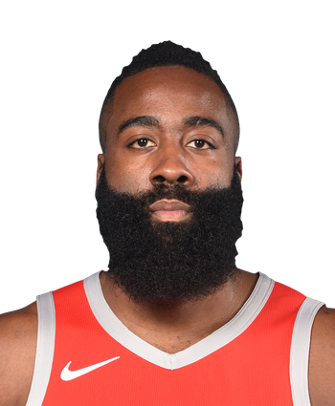
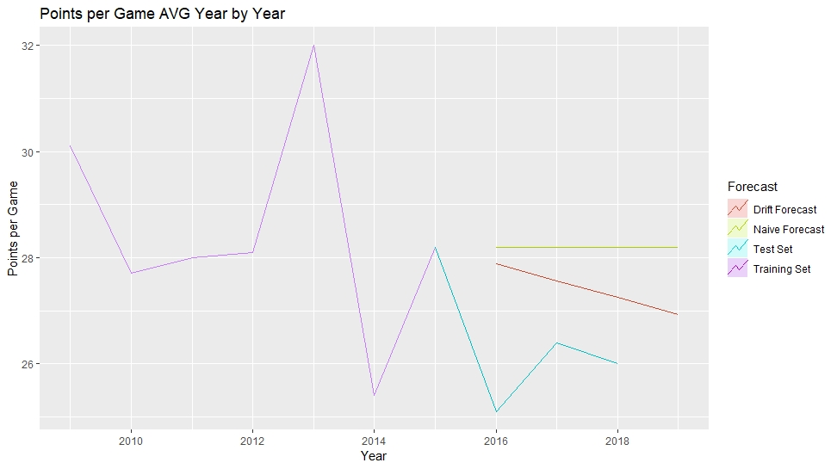
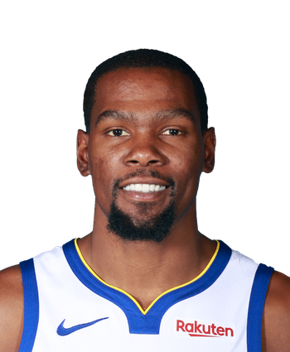
Visuals - PPG

Slide 10
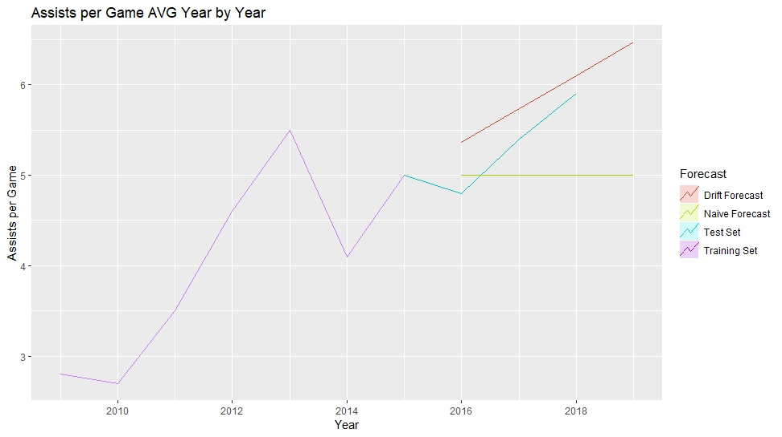
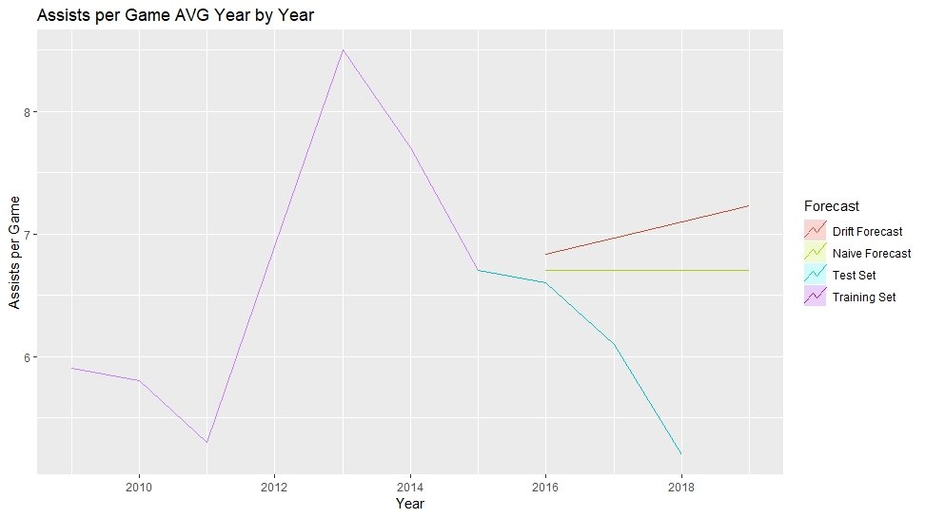
Accuracy Issue
Best Result
RMSE is not less that 10% of the mean of f(x)
Worst Result
This shows us that neither the drift method nor the naïve method are good predictors of future performance
The better results that we got were purely circumstantial
Cannot effectively predict future statistics

